Slide 1

Intro to Bio-Mechatronics
Smart Cane
Presented to: Dr./ Lamia Omran

Slide 2
Team members
Michael Nady 121900008
Mohammed Samir 191800079
Ali Tarek 191800015
AbdelRahman Hassan 121900013

Slide 3
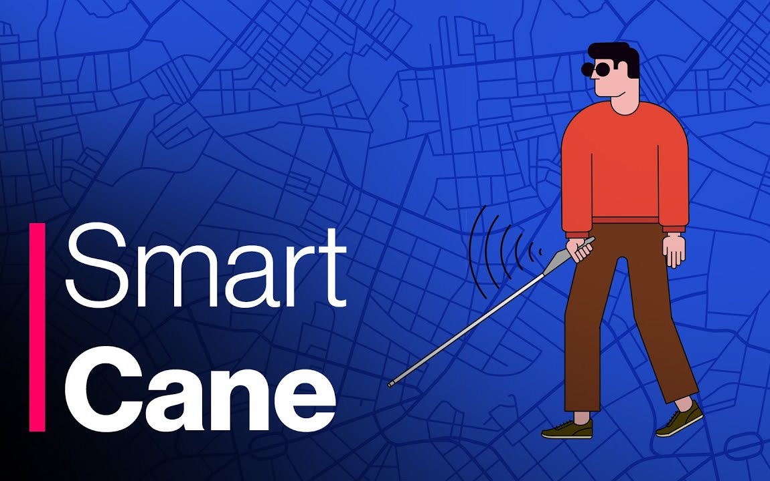
How it works?
The device sends out sound waves as the user walks.
When the sound waves hit an obstacle, an echo is produced, which travels back to the device,
According to the distance, the buzzer is triggered along with the vibration to notify the user about the obstacle.
The user can then change direction according to the intensity of the vibration and frequency of the buzzer.

Slide 4
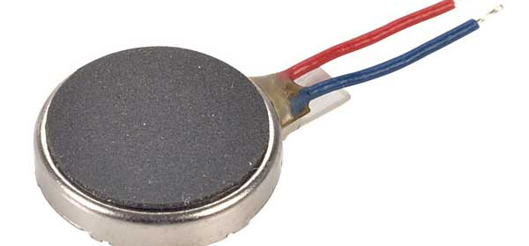
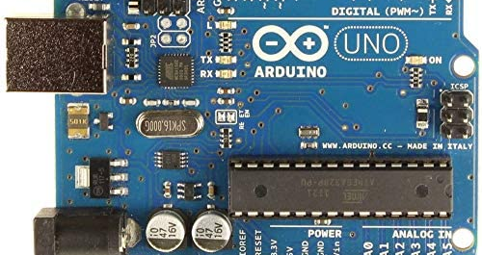
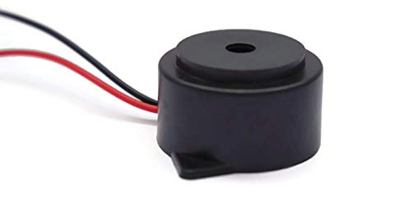
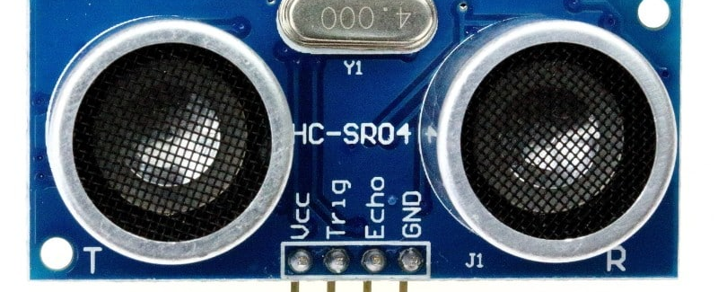
Components
Ultrasonic sensor
Buzzer
Vibrator
Arduino Uno

Slide 5
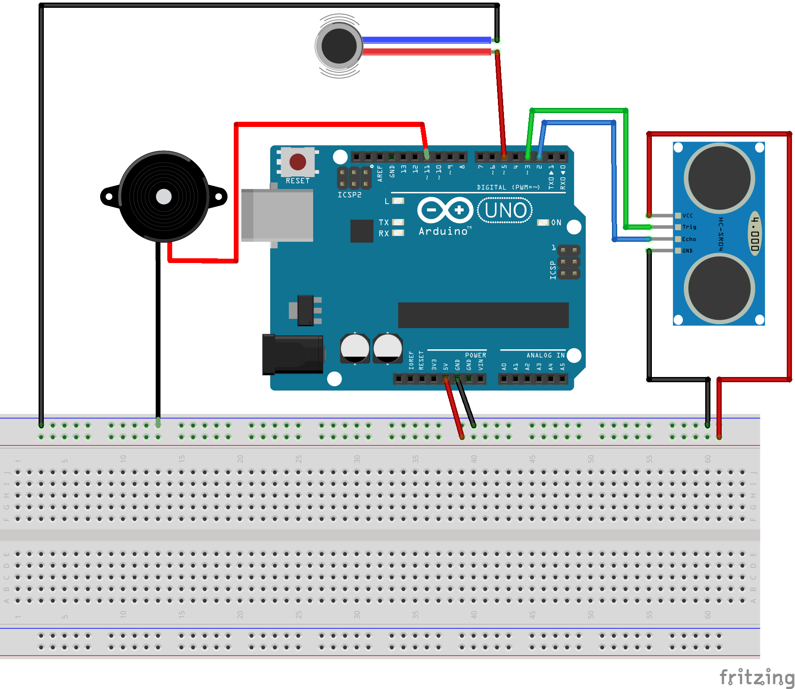
Schematic

Slide 6
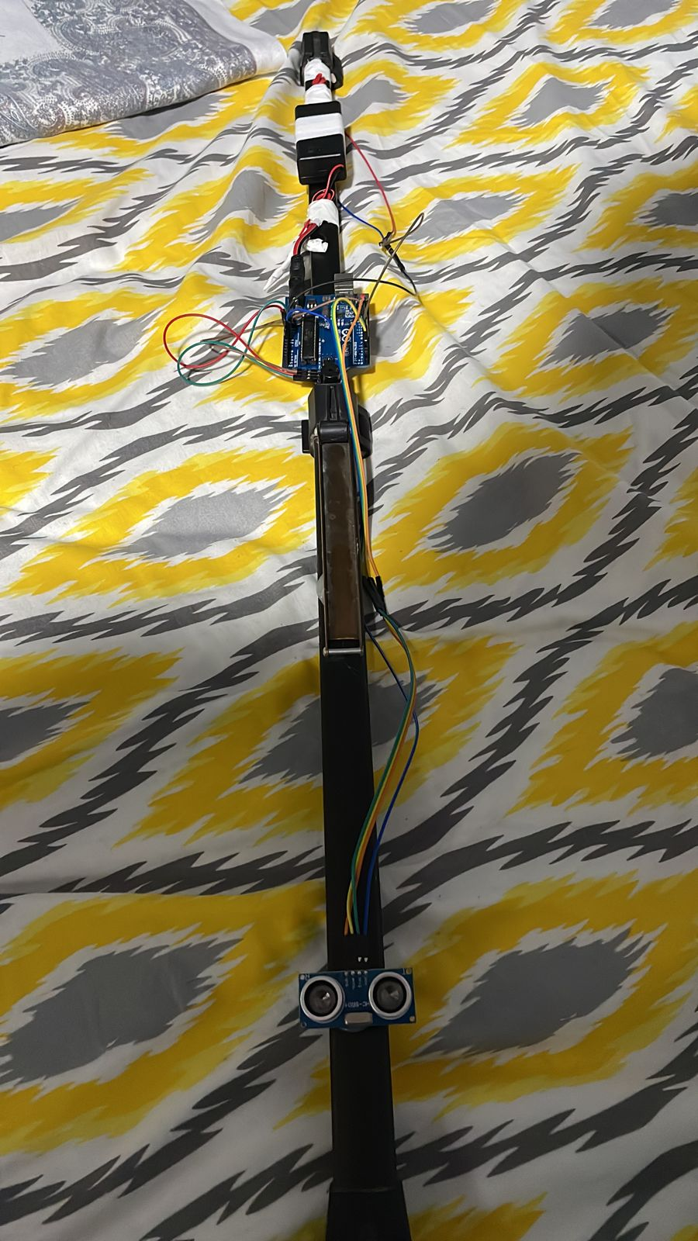
Model

Slide 7
Code/Programming
The smart cane is programmed to start buzzing/vibrating when distance between the person and the obstacle is less than xx cm.
As the distance decreases the frequency of the buzzer changes to signify the change

Slide 8

Thank you

